Slide 1
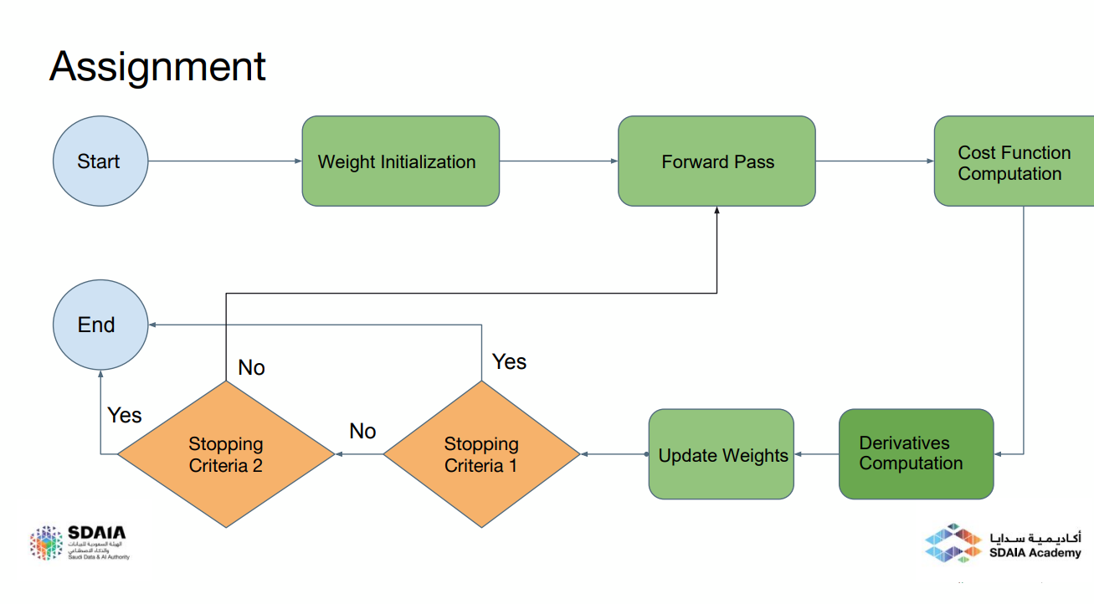
Maximum Iterations Reached?
Optimum Weights Reached?

Slide 2
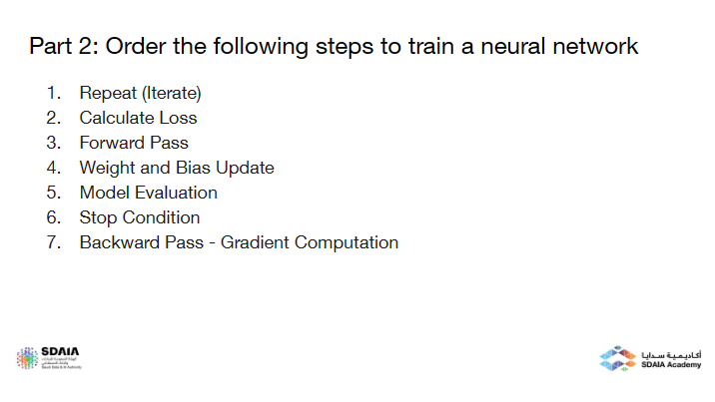
My Answer:
Forward Pass
Calculate Loss
Backward Pass - Gradient Computation
Weight and Bias Update
Repeat (Iterate)
Stop Condition
Model Evaluation

